Slide 1

US Dollar Exchange Rates: Asian Countries
Presented by Group 10:
Quraishi Abdallah, Mohammed Bahauddin
Monish Kumar Naidu Pinapala
Goutham Yallapu

Slide 2


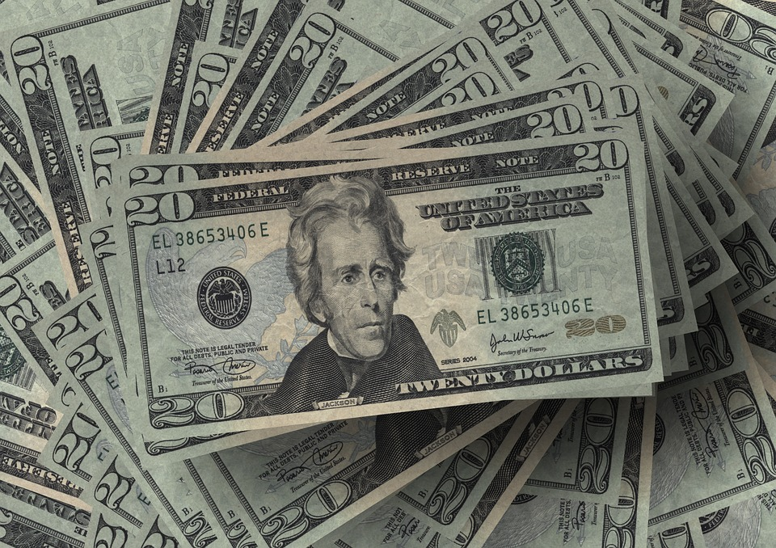


Introduction
The United states dollar is the official currency of United states of America.
It came into effect in 1792 under the coinage act passed by the U.S congress.
U.S. dollar became an important international reserve currency after the First World War and displaced the pound sterling as the world's primary reserve currency.
The dollar is the most widely used currency in international transactions.
And today we are here to compare the performance of well-known Asian currencies against the U.S dollar.

Slide 3
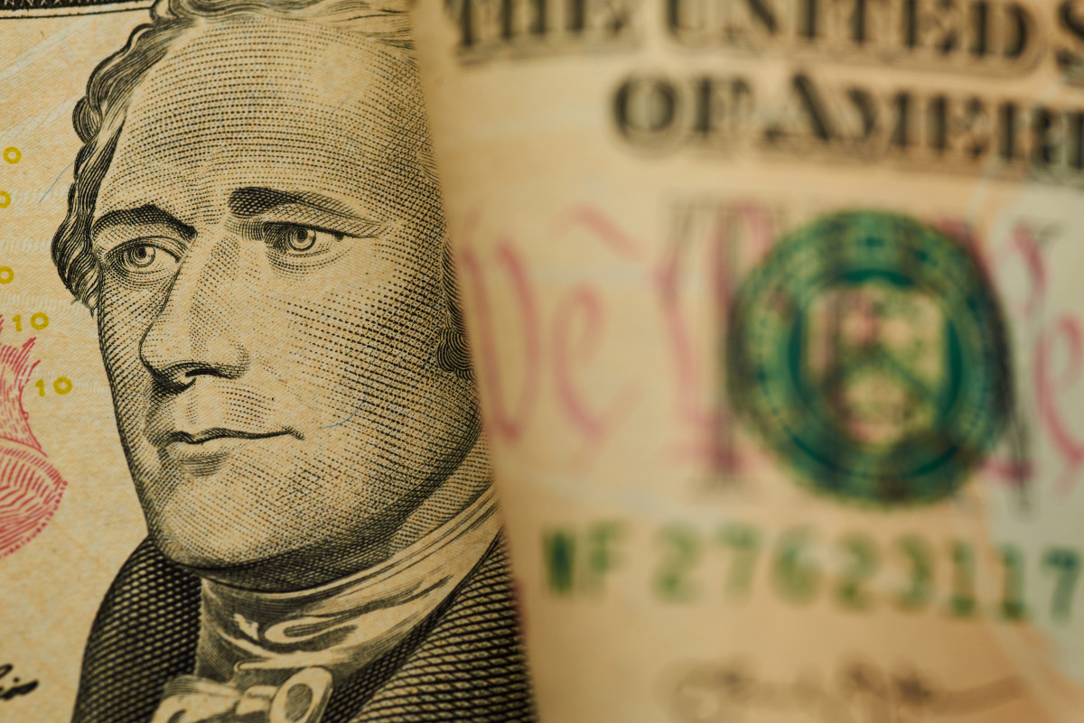

Background
We chose this topic because, USD being the most exchanged currency it is usually compared with similar heavyweights like EUR, GBP, CHF or AUD, but in the past decade there are many Asian currencies which have performed at par.
As we all know that Asian countries are rapidly developing nations in the current world and with the help of our dataset, we have analyzed the performance of various Asian currencies against the U.S dollar.

Slide 4



Research Question
Performance of U.S. dollar against well-known Asian country currencies over the past decade

Slide 5
Data Description
The dataset we used as part of this project is Dollar Exchange Rates: Asian Countries from Kaggle.
The variables in this dataset are date, currency ISO code and exchange rates.
The table on the right shows the Exchange rate of each currency against 1 USD as of April 2023.
CNY | 6.92
AFN | 86.00
INR | 81.93
IDR | 14935.50
KWD | 0.31
PKR | 278.86
JPY | 134.02
ILS | 3.64
MYR | 4.45
THB | 34.41

Slide 6
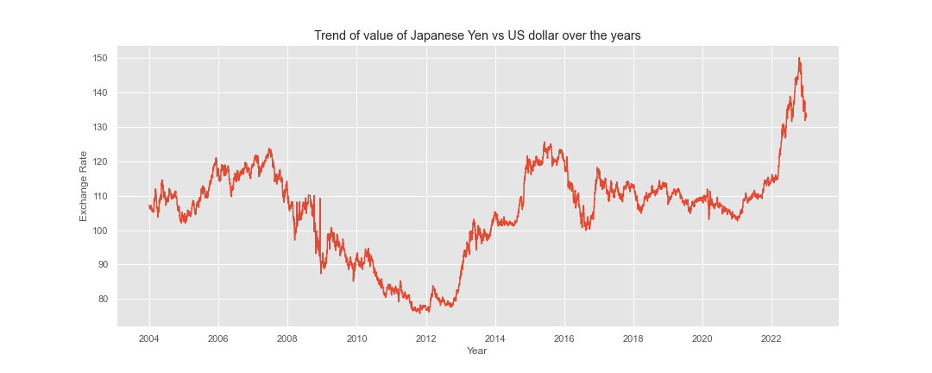
Trends of well-known International traded Asian currencies against the US dollar

Slide 7
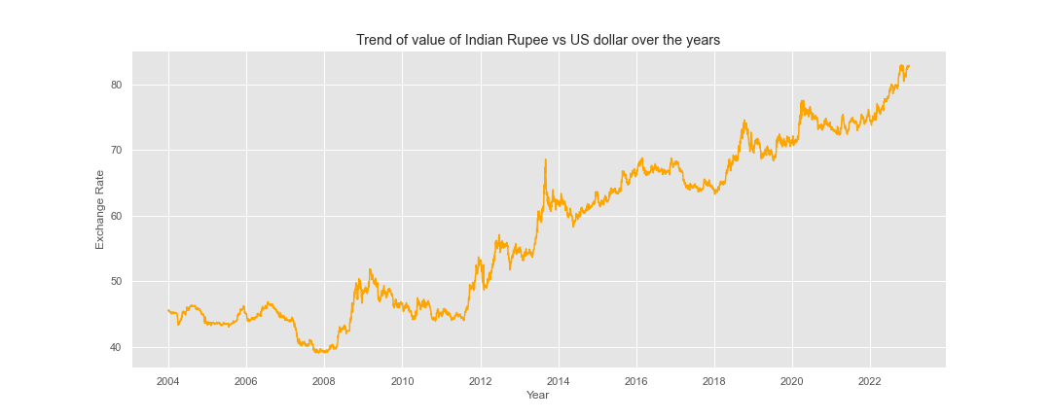

Slide 8
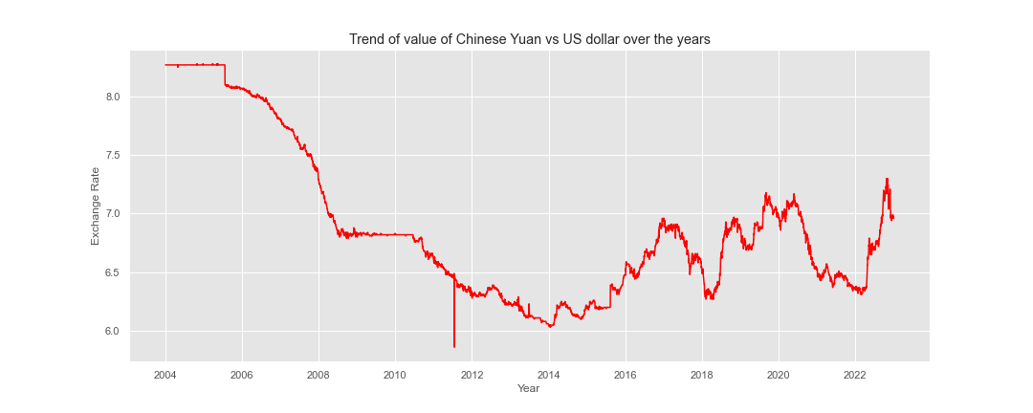

Slide 9


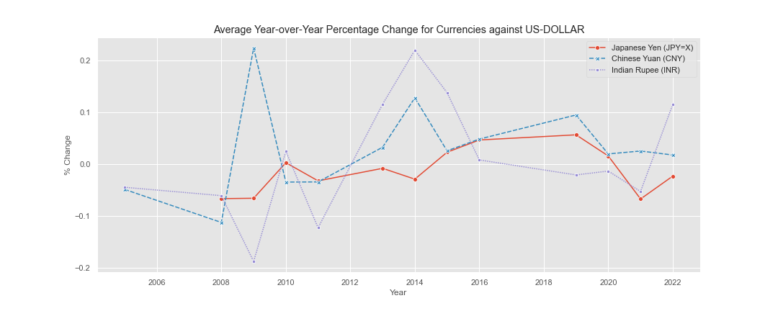
Average year over year Percentage change for currencies against US dollar

Slide 10
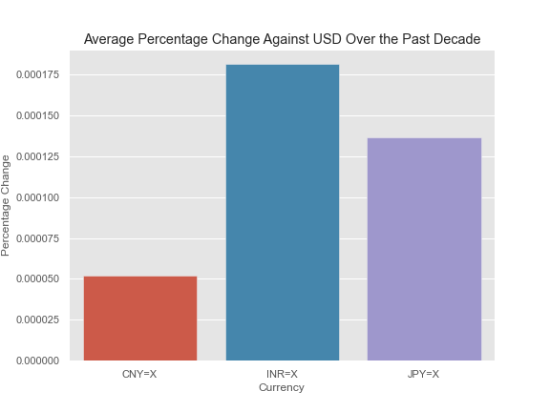
Performance of Dollar against currencies over the past decade

Slide 11

Conclusions and Findings:
In conclusion, majority of the Asian currencies have shown improvement against the US dollar over the past decade, but only a few of the major currencies still maintain a positive trend with consistency
Chinese yuan (CNY) - Which has grown positively against the US dollar, this is mainly due to China’s efforts to internationalize its currency.
Few major currencies have shown a downward trend against the USD:
Japanese yen (JPY) - JPY has a depreciating trend against the USD in the past decade, this is mainly due to the Bank of Japan’s monetary policies, which have led to a weaker yen.
Indian rupee (INR) - Like JPY, INR has also shown a depreciating trend against the USD, due to India's high inflation rates and current account deficit, which have led to a weaker rupee.

Slide 12
CITATIONS:
Dataset - https://www.kaggle.com/datasets/adilbhatti/dollar-exchange-rates-asian-countries
International Monetary fund – Current Exchage rates of different currencies

Slide 13
Q&A

Slide 14

Thank you

